Slide 1
Customer Churn Prediction
Presented by Tejasvini Sansare
12.10.2024

Slide 2
Introduction and Data Preparation
P A R T 0 1

Slide 3
Intro of background
The dataset is collected to predict the probability that whether the telecommunication customers will keep using the service or not.
Goal: Predict behavior to retain customers;
Give insight and strategic suggestions to increase retention rate.

Slide 4
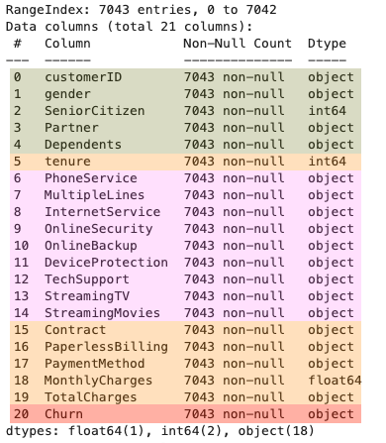
Dataset Information
Total count: 7043
Columns:
Demographic information (green)
Account feature (orange)
Signed up services (pink)
Consumers left within the last month (red)

Slide 5
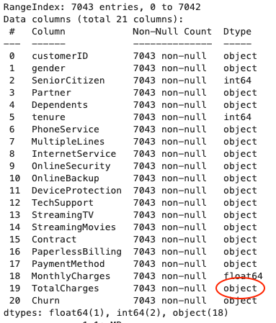
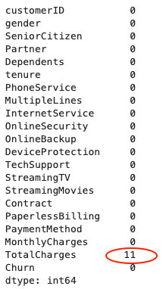
Data cleaning
Adjust data type
Check missing values
Address: impute with median

Slide 6
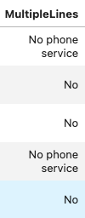
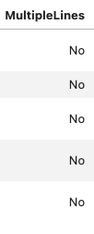
Data cleaning
Adjust inconsistency
Replace ‘No Phone/Internet services’ with ‘No’.
For our dataset, all services are dependent on two main services: phone services and internet services. ‘No services’ has no difference with ‘No’ to detect the retention effect when customers don’t have two main services.

Slide 7
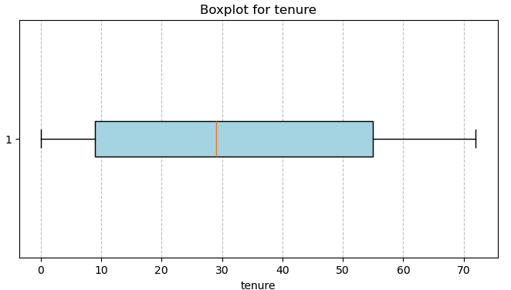
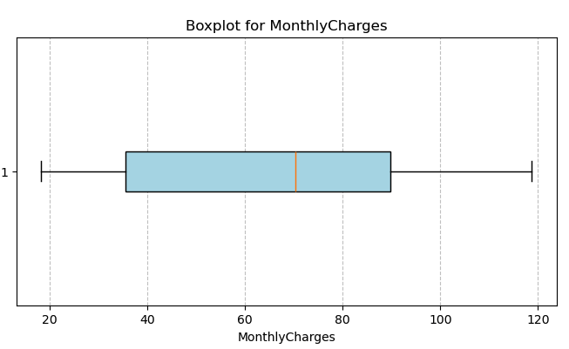
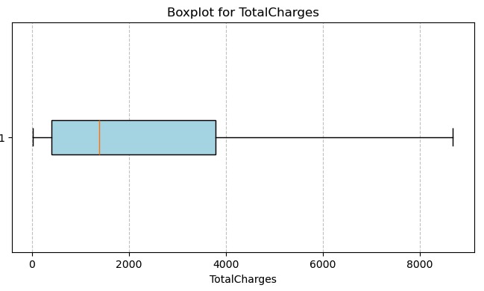
Data cleaning
Remove ‘CustomerID’ column
Convert "Partner", "Dependents", "Churn", "PaperlessBilling" to binary (Yes/No: 1/0)
Detect outliers for numerical columns

Slide 8
Exploratory Data Analysis
P A R T 0 2

Slide 9
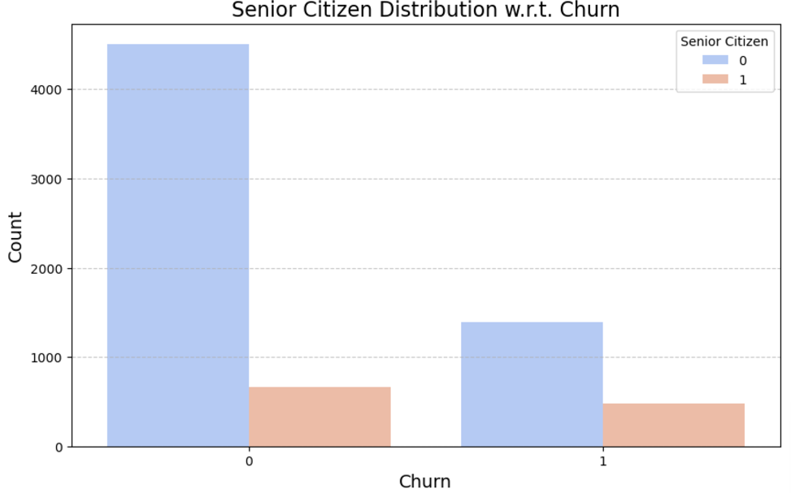
Customer Demographics – Senior citizens
Senior citizens have a higher probability of churning, but they constitute a small fraction of the customer base.

Slide 10
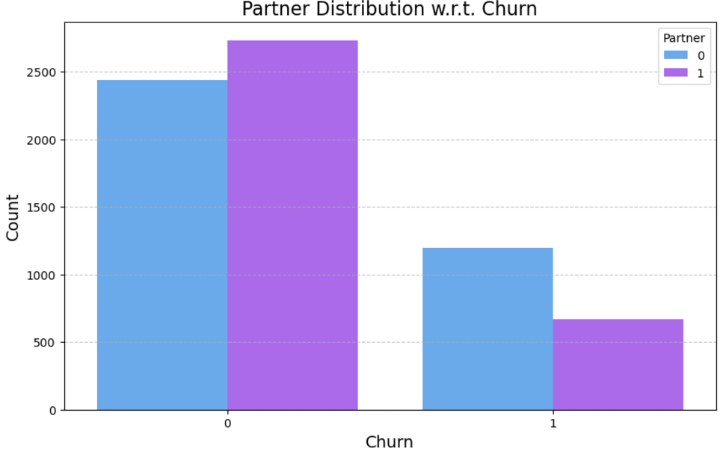
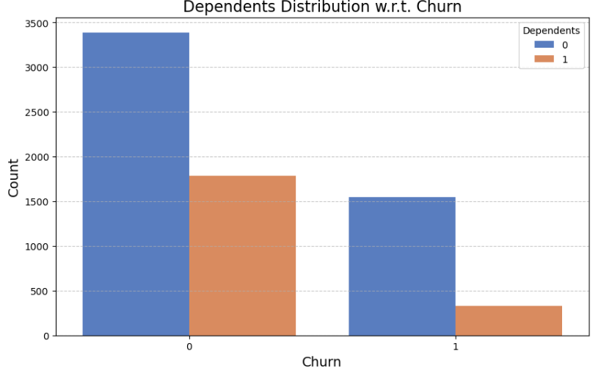
Customer Demographics – Partner and Dependents
Single customers (no dependents, no partner) are more likely to churn.

Slide 11
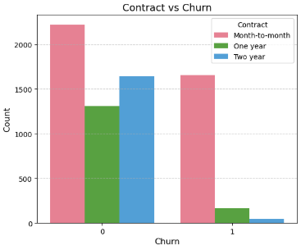
Account Features – Contract Type
Month-to-month contracts have higher churn compared to longer-term contracts.

Slide 12
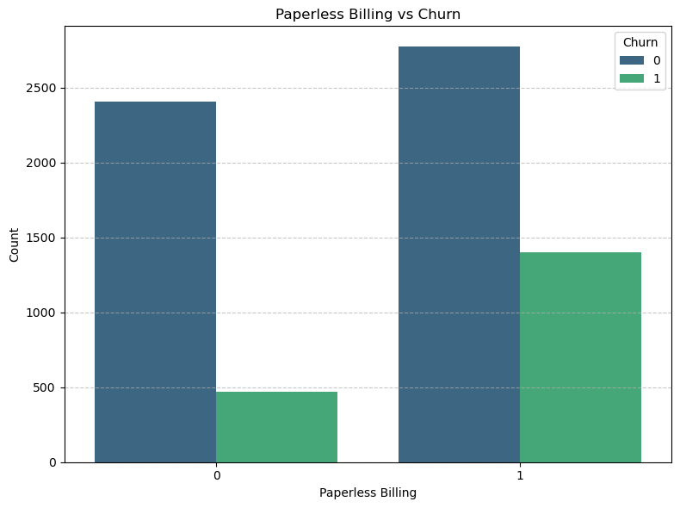
Account Features – Paperless billing
Customers with paperless billing show a higher churn rate.

Slide 13
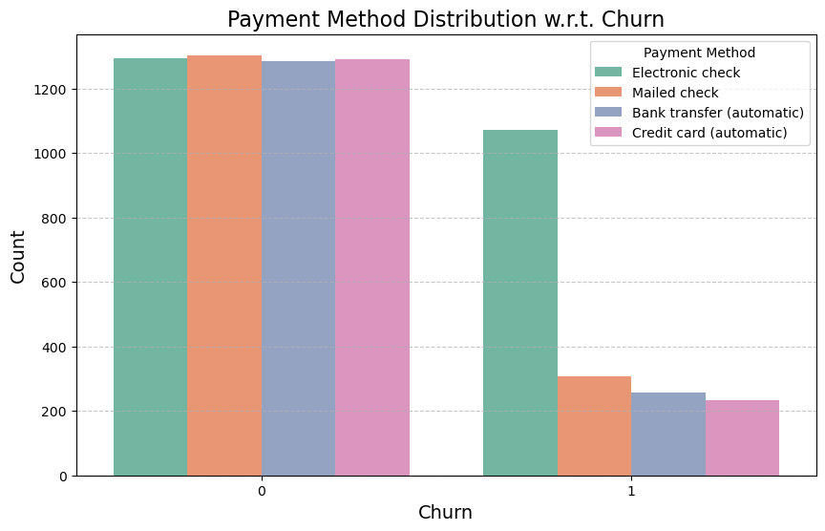
Account Features – Payment Methods
Customers paying via electronic check are the most likely to churn.

Slide 14
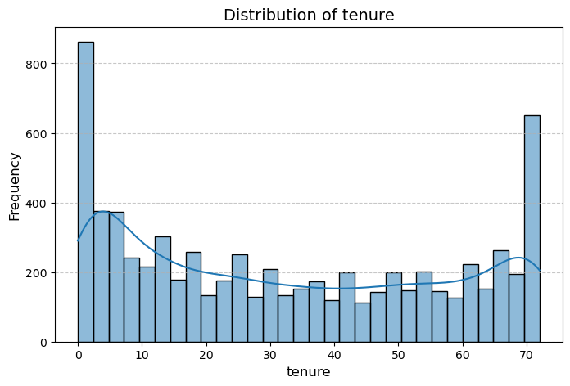
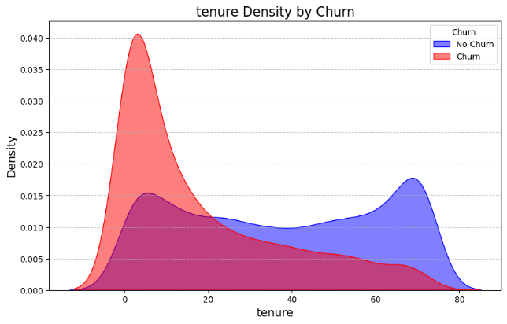
Account Features – Tenure
Tenure distribution: This distribution is bimodal, with peaks at the low and high tenure ranges.
Tenure vs Churn: Customers with short tenure (<10 months) are more likely to churn, indicating the importance of onboarding and early engagement strategies.

Slide 15
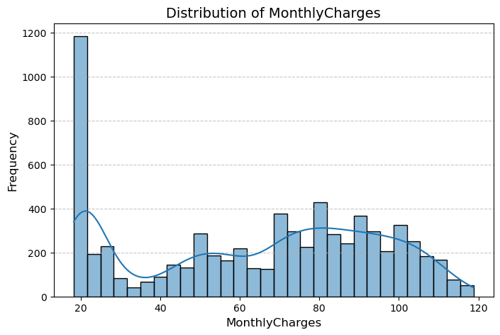
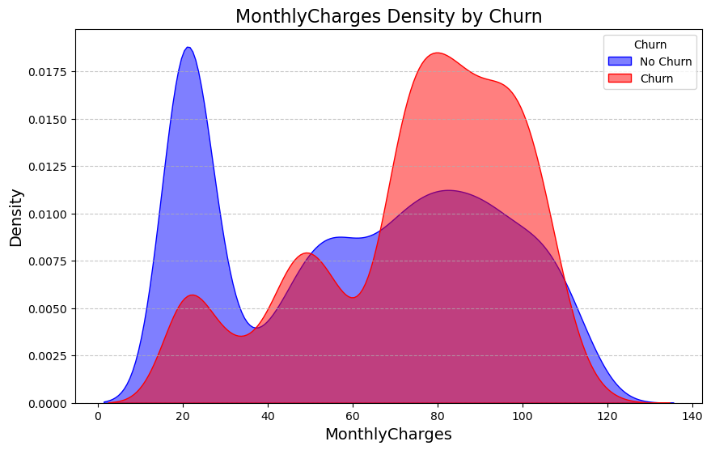
Account Features – Monthly charges
Monthly charges distribution: There is a concentration around $20-30 and 70-100, indicating most customers have lower monthly charges.
Monthly charges vs Churn: Churn rate increases as monthly charges increase generally, with the highest density observed between $70 and $100.

Slide 16
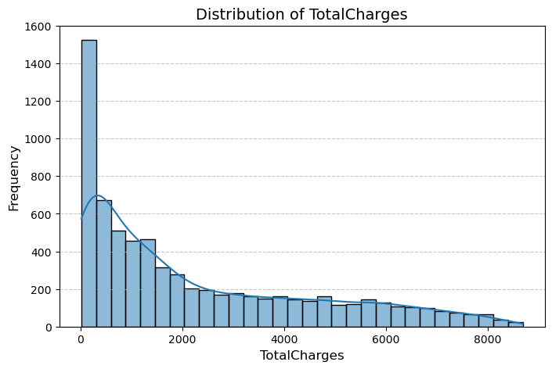
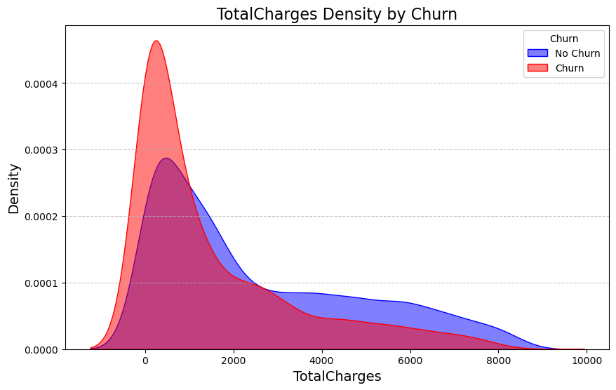
Account Features – Total charges
Total charges distribution: It’s heavily concentrated at the lower range around $0–500. The distribution is right-skewed, showing a clear long tail extending toward very high total charges.
The density is higher for lower total charges (below $1,000), indicating newer customers are at higher risk of churn because lower total charges correlate with shorter tenures.

Slide 17
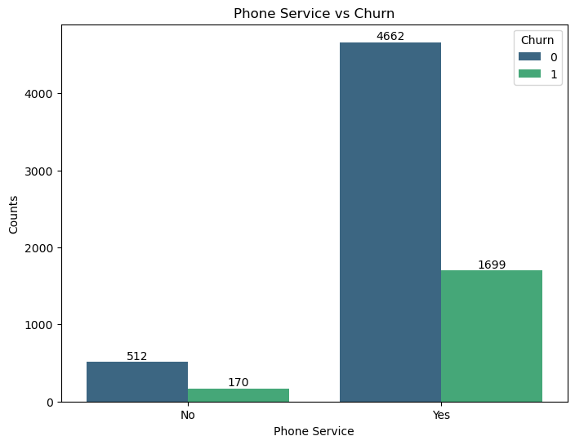
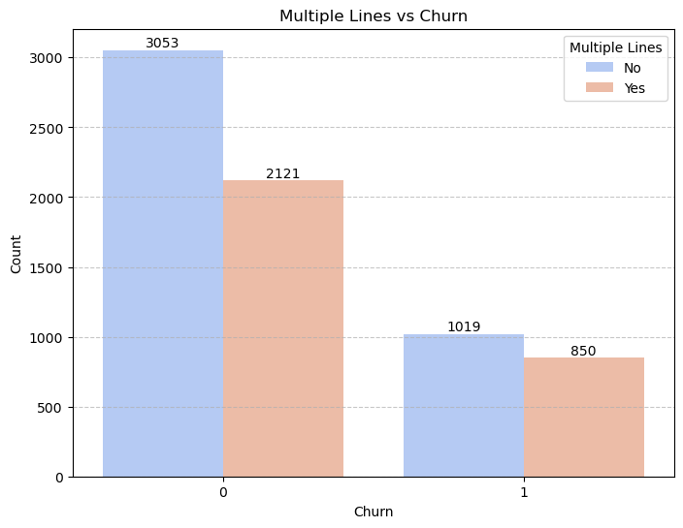
Usage Patterns – Phone Service and Multiple Lines
Customers with phone services are more likely to churn, especially when they have multiple lines.

Slide 18
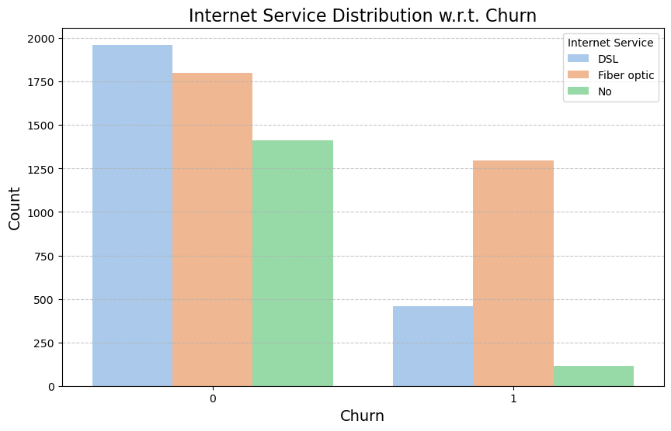
Usage Patterns – Internet Service
Customers who use Fiber optic have higher churn rate than DSL and no service.

Slide 19
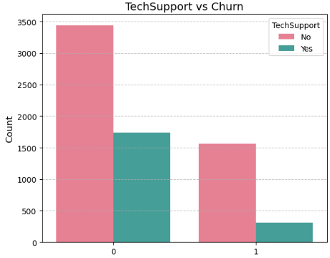
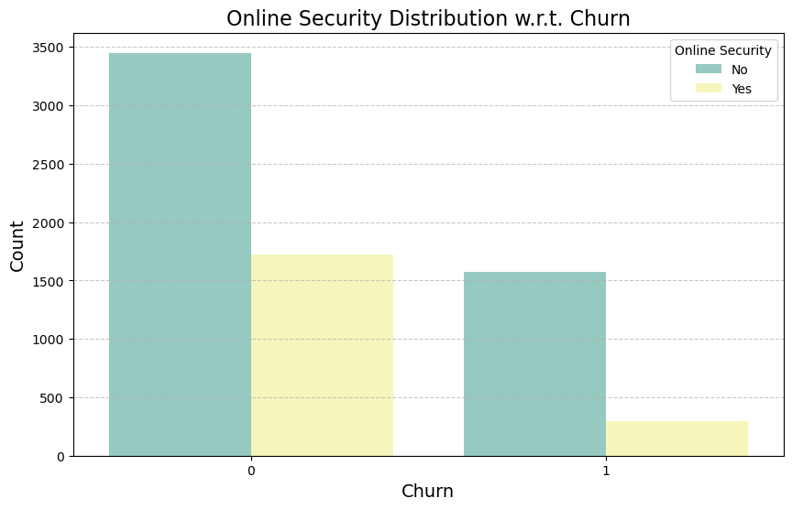
Usage Patterns – Tech Support and Online Security
Customers without tech support or online security are more likely to migrate to another service provider.

Slide 20
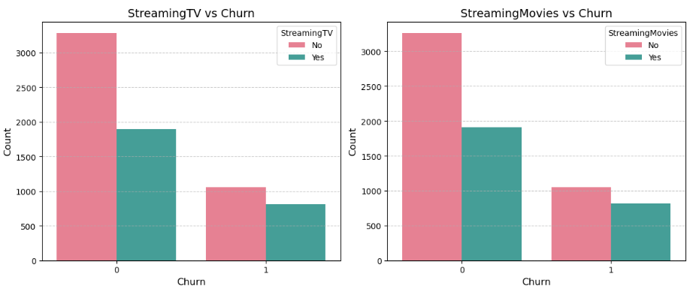
Usage Patterns – Streaming Services (TV and Movies)
Customers subscribed to streaming services (both TV and movies) are slightly more likely to churn.

Slide 21
Modeling and Key Takeaways
P A R T 0 3

Slide 22
Modeling
Objective
Develop a predictive model to identify customers at high risk of churn.
Leverage insights from the model to inform targeted retention strategies.
Model Used: Logistic Regression Chosen due to:
Simplicity and interpretability.
Ability to quantify the relationship between features and churn probability.
Well-suited for binary classification problems.
Workflow:
Data Preparation:
Encoded categorical variables using One-Hot Encoding.
Scaled numerical features using StandardScaler.
Train-Test Split:
80% training, 20% testing split for robust evaluation.
Model Training:
Logistic regression fitted on selected features.
Evaluation:
Performance metrics: Accuracy, Precision, Recall, F1-score, and ROC-AUC.

Slide 23
Model Evaluation: Confusion Matrix
Insights:
True Negatives: Correctly predicted customers who will not churn.
True Positives: Correctly predicted customers who will churn.
False Negatives: Missed predictions where churners were classified as non-churners.
False Positives: Non-churners incorrectly classified as churners.
Confusion Matrix
933(TN) | 103(FP)
149(FN) | 224(TP)
Key Takeaways:
High Accuracy for Non-Churners:
The model accurately identifies 933 non-churners out of 1036 total non-churn cases.
Churn Prediction Needs Improvement:
The model misses 149 churners, leading to lower recall for predicting churn.
Business Impact:
Misclassifying churners (false negatives) could result in missed opportunities for retention efforts.

Slide 24
Model Evaluation: Classification Report
Key Takeaways:
Balanced Accuracy:
Overall model accuracy is 82%, showing good general performance.
Class Imbalance in Performance:
Class 0 (Non-Churners) has higher precision, recall, and F1-score compared to Class 1 (Churners).
Improvement Opportunity:
Low recall for churners (0.60) indicates room for improvement in capturing customers at risk of churning.
Macro vs. Weighted Averages:
Weighted averages are close to accuracy, indicating the model performs well on the majority class.
 | Precision | Recall | F1- Score | Support
0 (Non Churners) | 0.86 | 0.90 | 0.88 | 1036
1 (Churners) | 0.69 | 0.60 | 0.64 | 373
Accuracy |  |  | 0.82 | 1409
Macro Avg | 0.77 | 0.75 | 0.76 | 1409
Weighted Avg | 0.82 | 0.82 | 0.82 | 1409

Slide 25
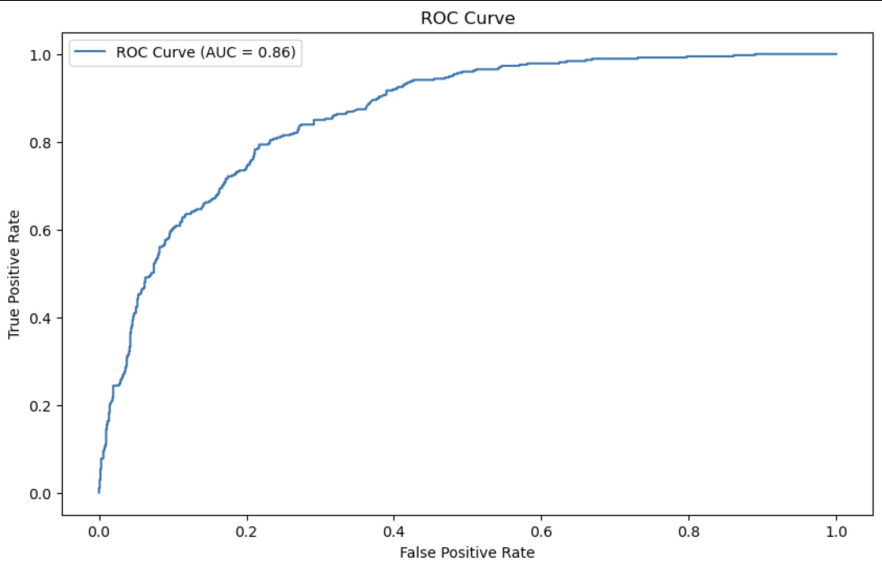
Model Evaluation: ROC-AUC Curve
Key Takeaways:
Strong Model Discrimination:
ROC-AUC score of 0.86 shows the model effectively separates churners from non-churners.
Visual Representation:
The ROC curve highlights a good balance between the true positive rate and false positive rate.
Focus Area:
AUC indicates strong overall performance, but the model's performance on Class 1 (Churners) could still improve to enhance sensitivity.

Slide 26
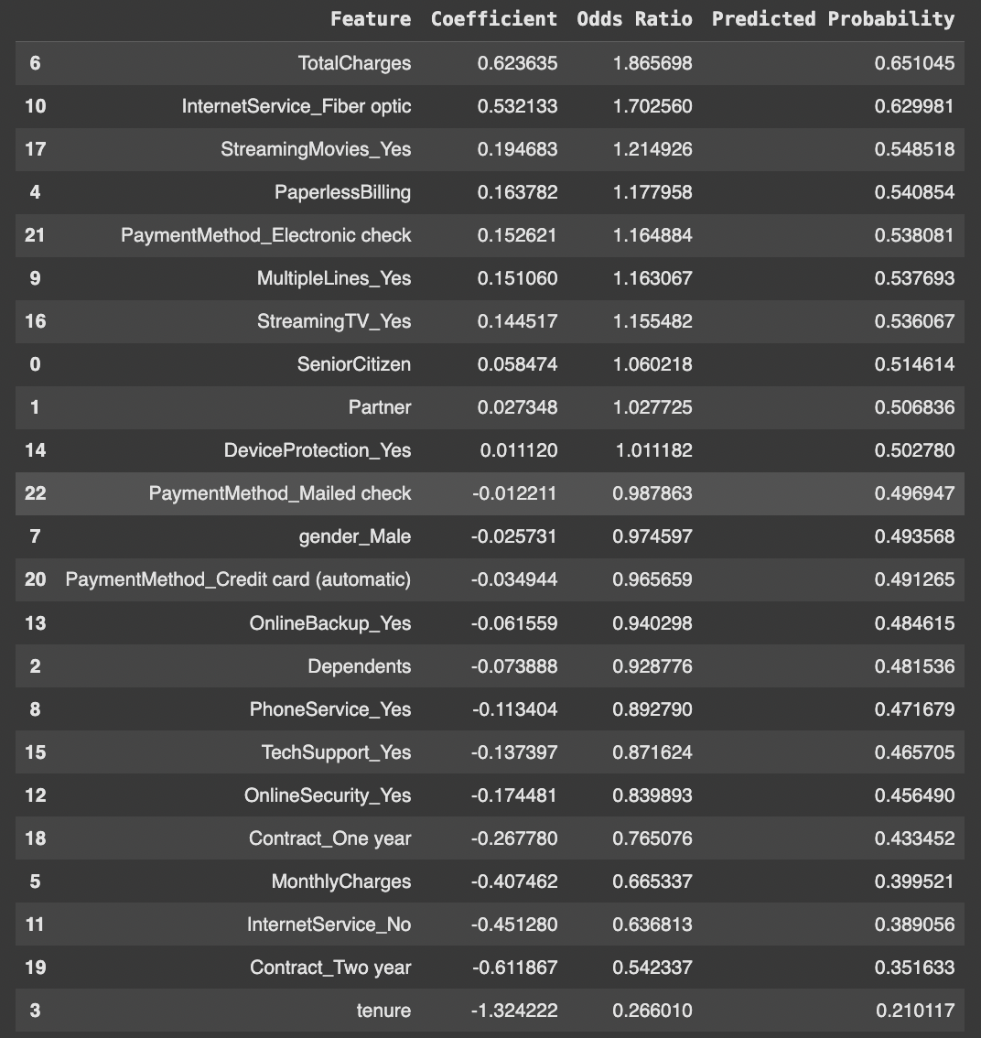
Coefficient, Odds Ratio, and Predicted Probability Analysis
Coefficients reveal the influence of each feature on churn probability.
Positive values indicate factors that increase churn risk.
Negative values indicate factors that reduce churn risk.
Odds Ratios translate coefficients into understandable metrics.
Show the change in odds of churn per unit increase in the feature.
Predicted Probabilities help quantify the actual risk.
Allow us to prioritize features based on their impact on churn likelihood.

Slide 27
Contd: Key Takeaways
Top Influential Features:
TotalCharges: Odds ratio of 1.865 indicates higher total charges increase churn likelihood significantly.
InternetService_Fiber optic: Odds ratio of 1.702 highlights the increased churn risk associated with fiber optic internet service users.
Least Influential Features:
tenure: Odds ratio of 0.266 indicates longer tenure significantly reduces churn likelihood.
Contract_Two year: Odds ratio of 0.542 shows customers with two-year contracts are less likely to churn.
Predicted Probability:
High predicted probabilities for features like TotalCharges (0.651) and StreamingMovies_Yes (0.548) indicate these customers are at higher churn risk and need focused attention.

Slide 28
Key Insights and Strategic Recommendations
Conclusion
The logistic regression model achieved 82% accuracy and an ROC-AUC score of 0.86, with strong performance in predicting non-churners (86% precision, 90% recall).
Key predictors: Higher TotalCharges and Fiber optic internet increase churn risk, while longer tenure and multi-year contracts reduce it, enabling targeted interventions for retention.
Business Recommendations
Target At-Risk Customers:
Prioritize outreach for customers with high TotalCharges or Fiber optic internet service.
Provide personalized offers, discounts, or additional perks to these customers.
Encourage Long-Term Contracts:
Promote one- and two-year contracts by offering incentives, ensuring better customer retention.
Improve Service Offerings:
Address specific issues related to Fiber optic service and provide value-added features to enhance customer satisfaction.
Implement Loyalty Programs:
Reward loyal customers with longer tenure through special promotions or rewards, strengthening retention.

Slide 29
Q & A

Slide 30
Thank You!

